Slide 2
Overview
2008 GFC: In response to the 2008 crisis, contingent convertible (CoCo) are introduced as a mechanism to strengthen bank stability by automatically converting debt into equity during financial distress.
March 19, 2023: The Swiss Financial Market Supervisory Authority (FINMA) announces the complete write-down of Credit Suisse's Additional Tier 1 (AT1) bonds, amounting to approximately CHF 16 billion.
Going forward: Dynamic Control of Leverage (DCL) introduced to prevent sudden drawdowns by only drawing down interest payments during times of high leverage, therefore gradually adjusting the balance sheet.
My thesis is about analysing DCLs in real world scenarios.

Slide 3
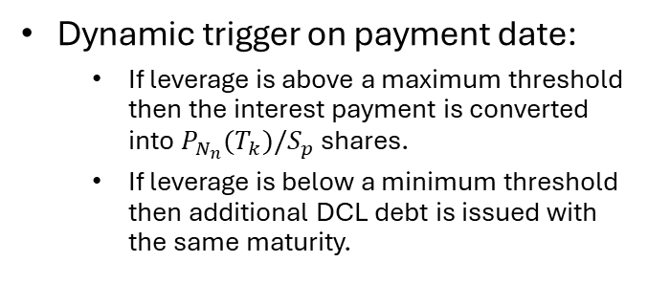

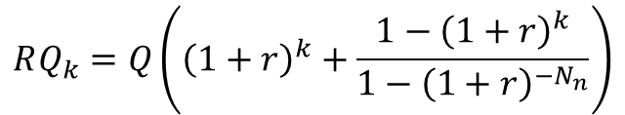
Dynamic Control of Leverage (DCL)
$$P_{N_{n}}\left(T_{i}\right)=\frac{rQ}{1−{\left(1+r\right)}^{−N_{n}}}$$
$$RQ_{k}=Q\left({\left(1+r\right)}^{k}+\frac{1−{\left(1+r\right)}^{k}}{1−{\left(1+r\right)}^{−N_{n}}}\right)$$
$$L_{k}=\frac{Total debt}{Total debt+Total equity}=\frac{RQ_{k}}{RQ_{k}+α_{k}∗NS_{k−1}∗S_{k}}$$
Dynamic trigger on payment date:
If leverage is above a maximum threshold then the interest payment is converted into $P_{N_{n}}(T_{k})/S_{p}$ shares.
If leverage is below a minimum threshold then additional DCL debt is issued with the same maturity.

Slide 4
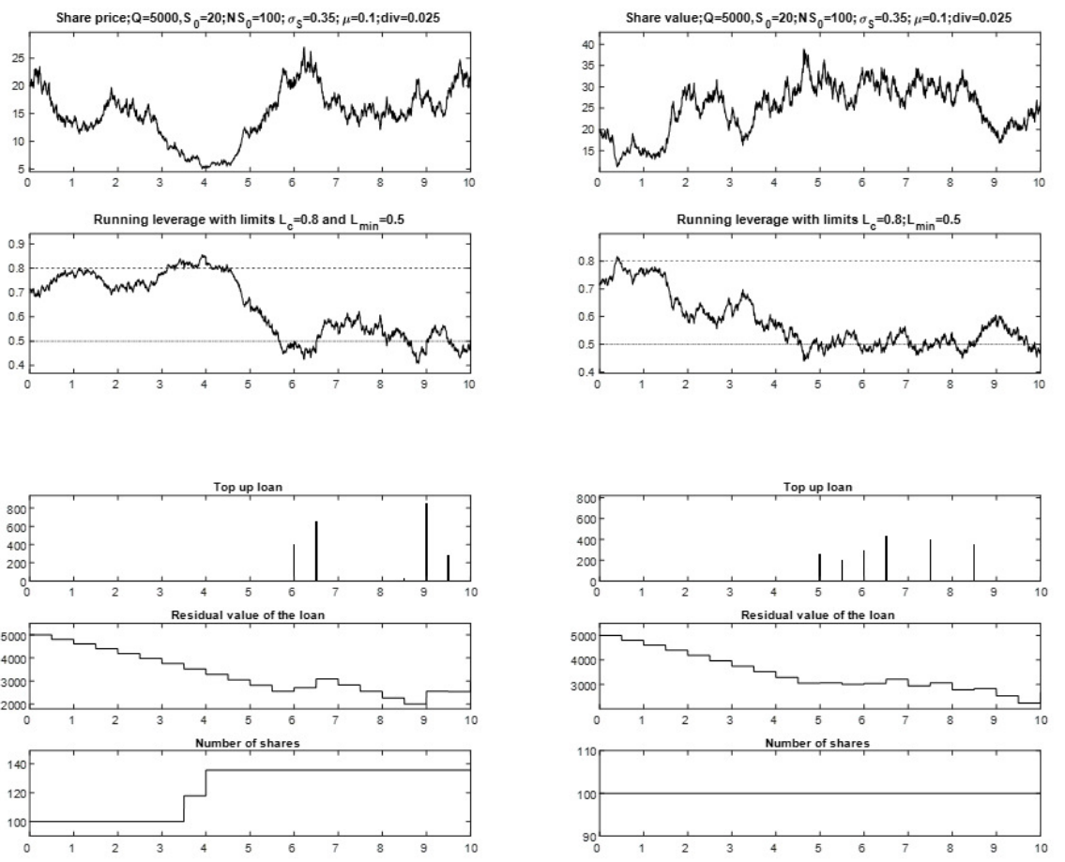
Theoretical Case Study

Slide 5
Real world simulations & Research questions
How would DCL bonds behave in the real world scenarios?
Would DCL have saved Credit Suisse?
What effect would DCL have for banks in the real world?
How do DCL parameters affect the outcomes?
Leverage triggers (minimum and maximum)
Frequency of payments and adjustments
Conversion price

Slide 6
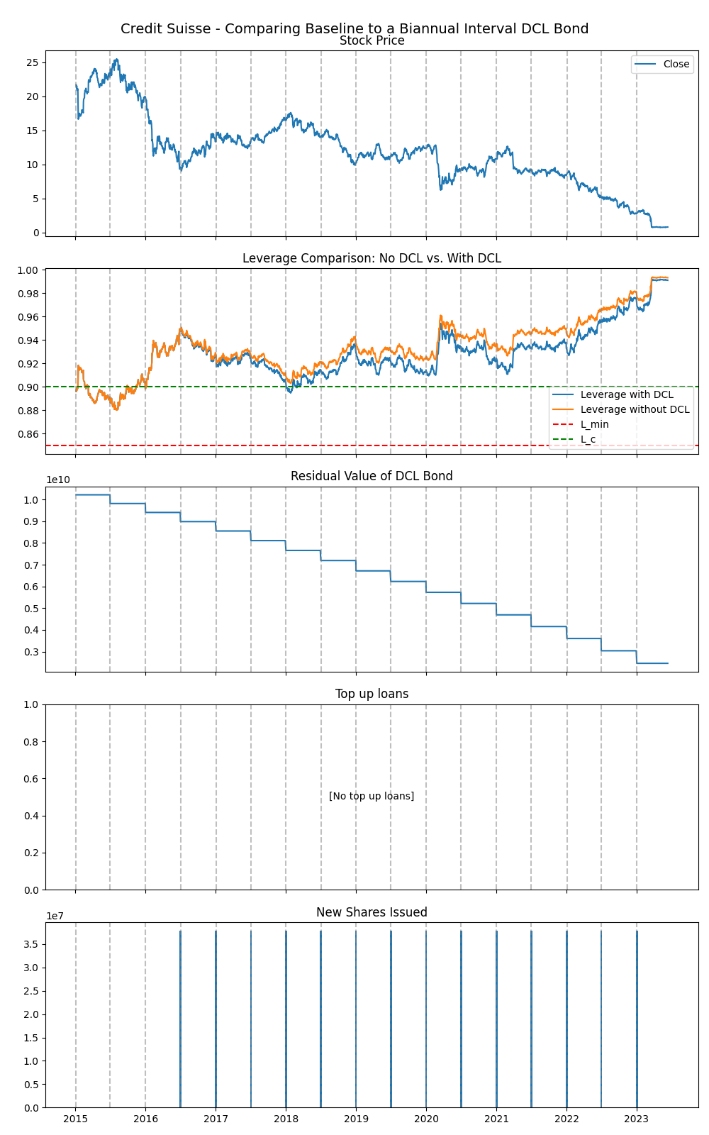
Simulating DCL bonds
Baseline model parameters:
Biannual payment and adjustments
Conversion price set the initial share price
Initial nominal value set to equal historical AT1 debt at issuance.
Maximum leverage at 95%
Minimum leverage at 85%
Results from simulation:
High leverage
No minimum trigger breaches
Early and frequent upper trigger breaches

Slide 7
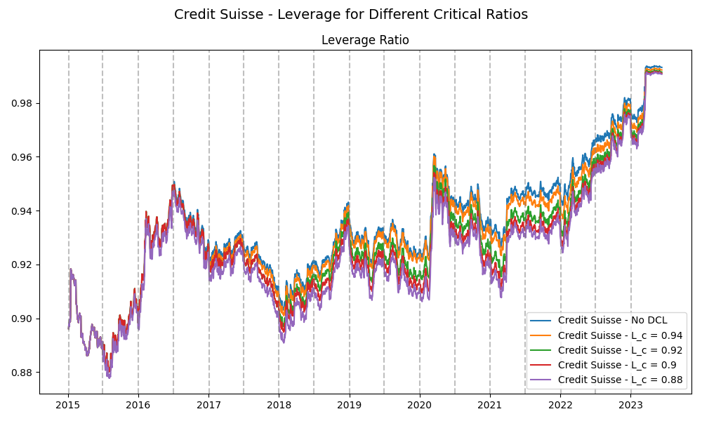

Slide 8
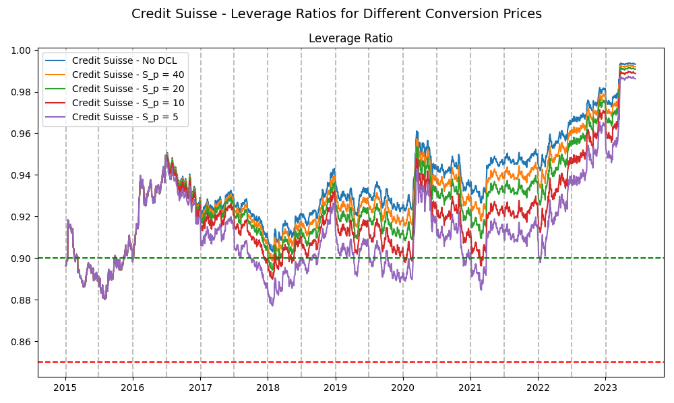

Slide 9
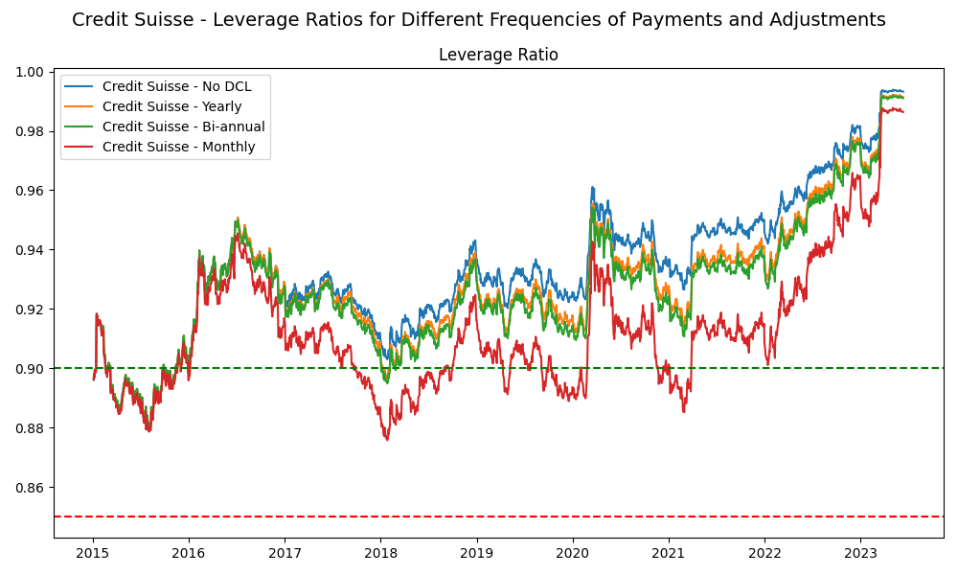

Slide 10
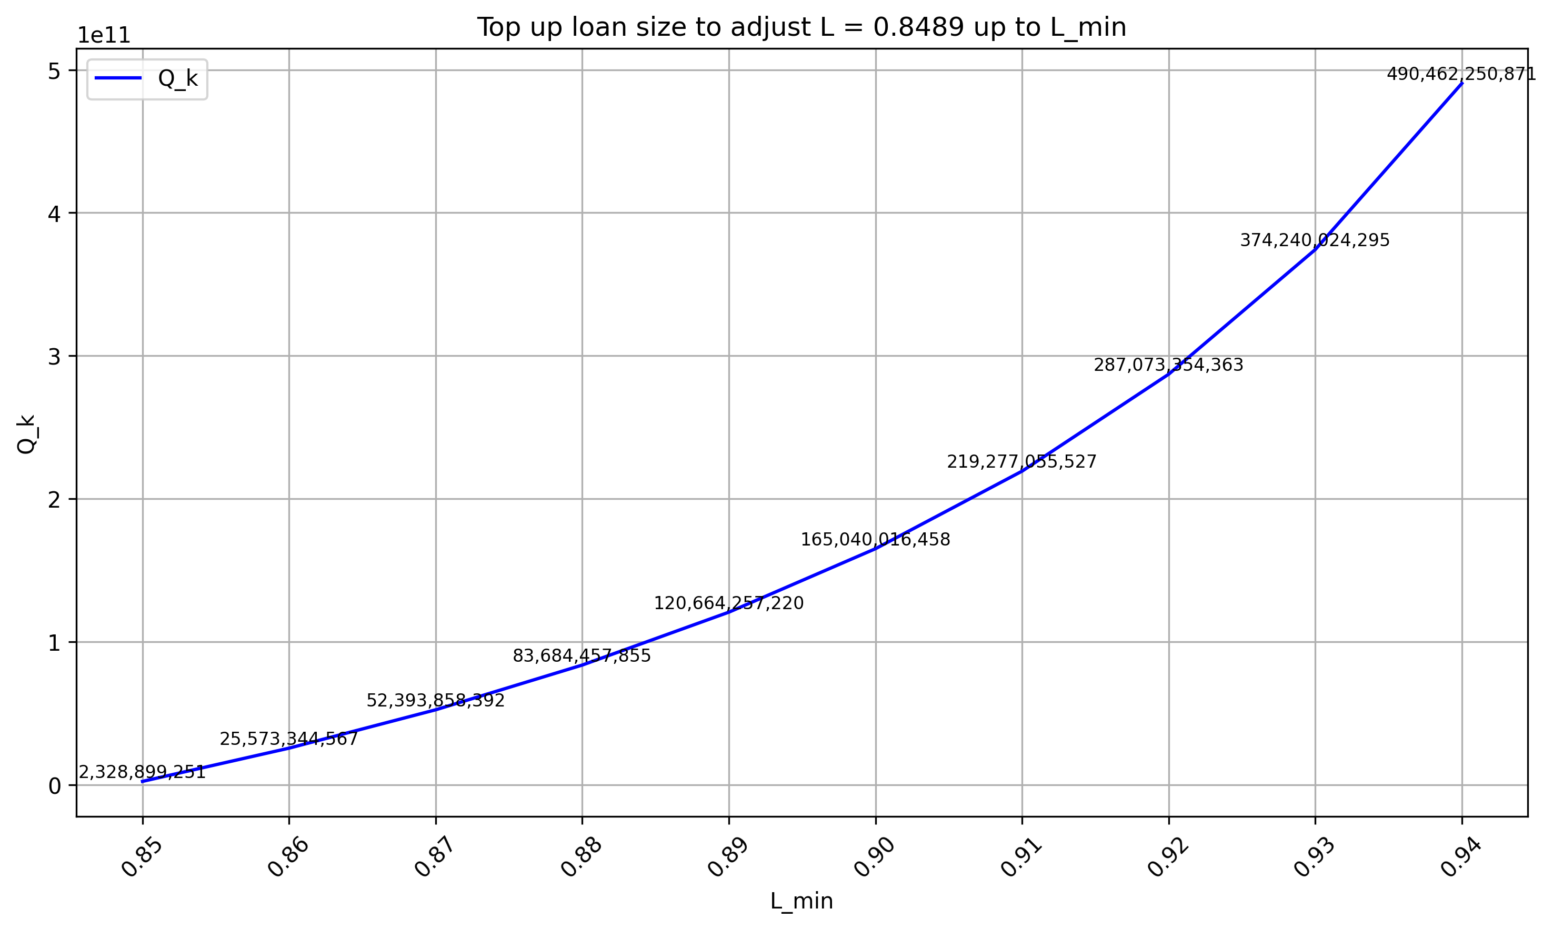
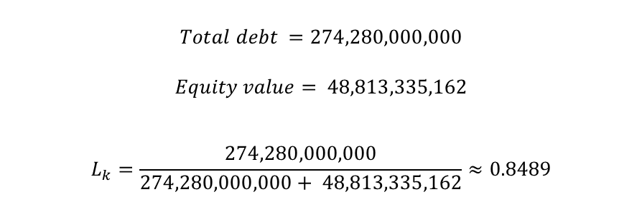
Minimum trigger breaches for highly levered companies
$$Total debt =274,280,000,000$$
$$Equity value= 48,813,335,162$$
$$L_{k}=\frac{274,280,000,000}{274,280,000,000+ 48,813,335,162}≈0.8489$$

Slide 11
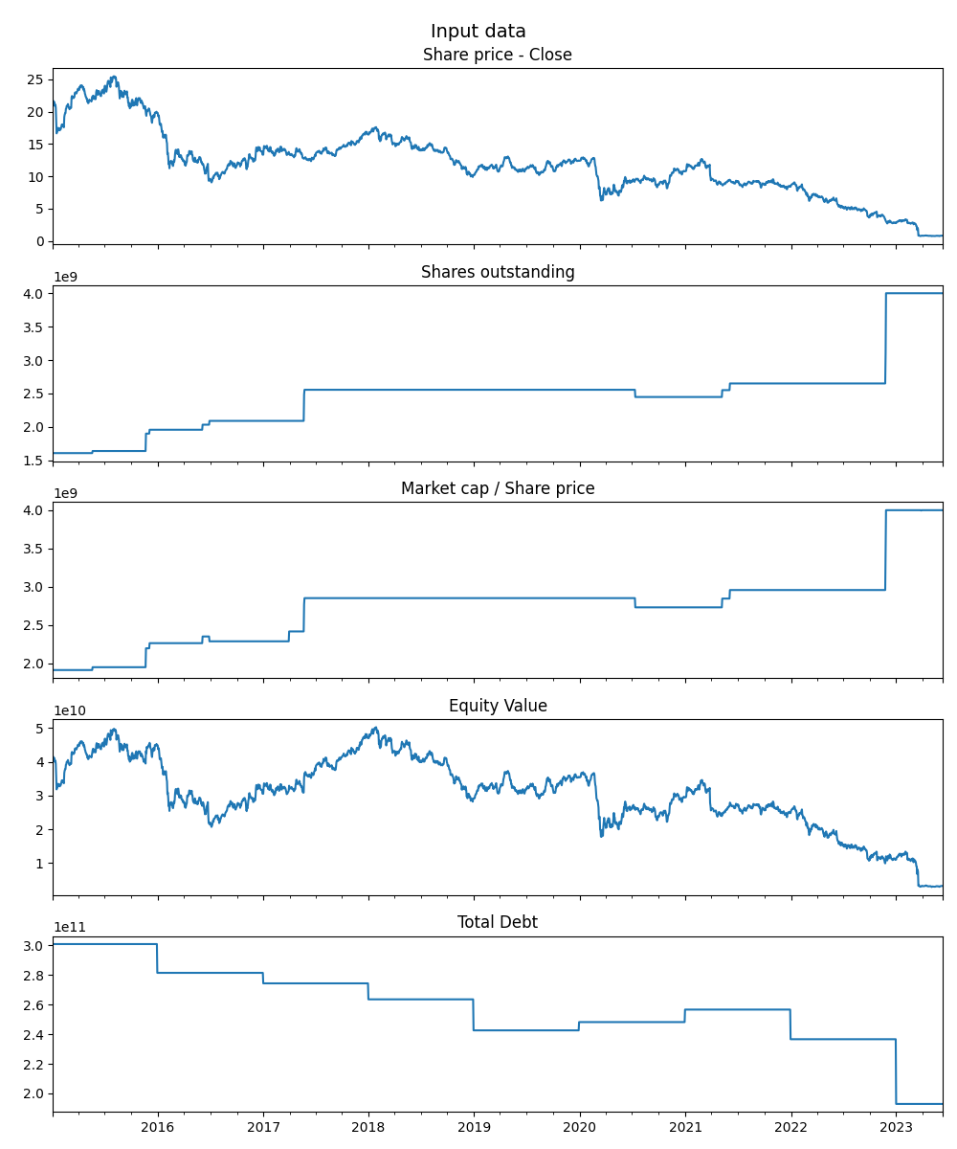
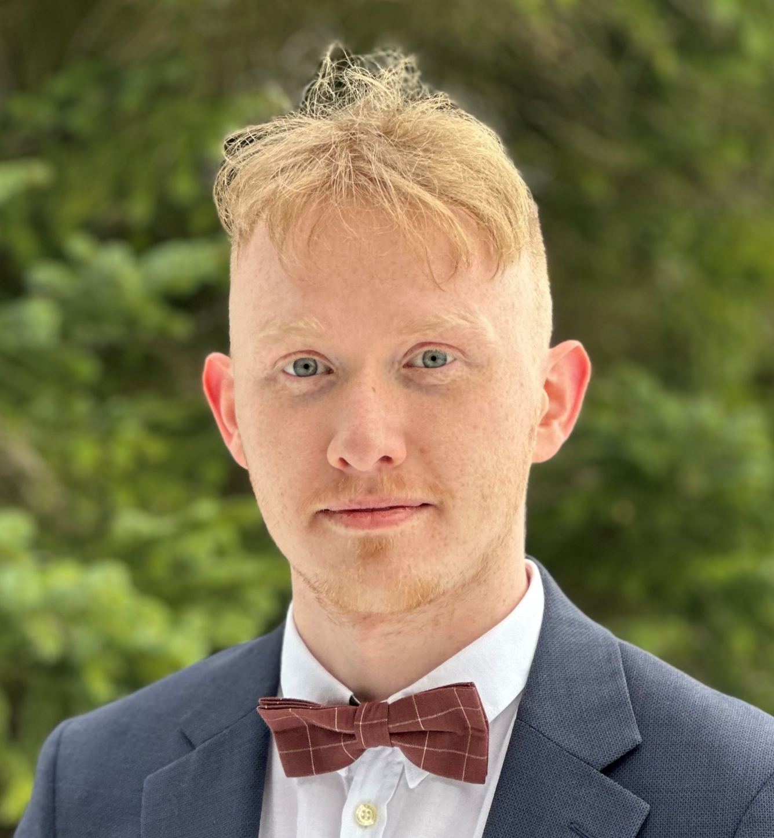
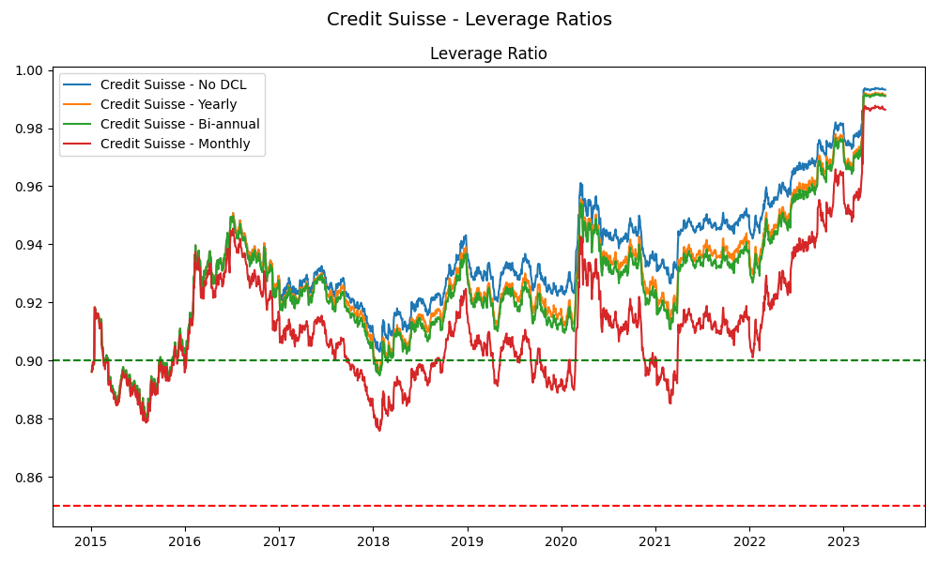
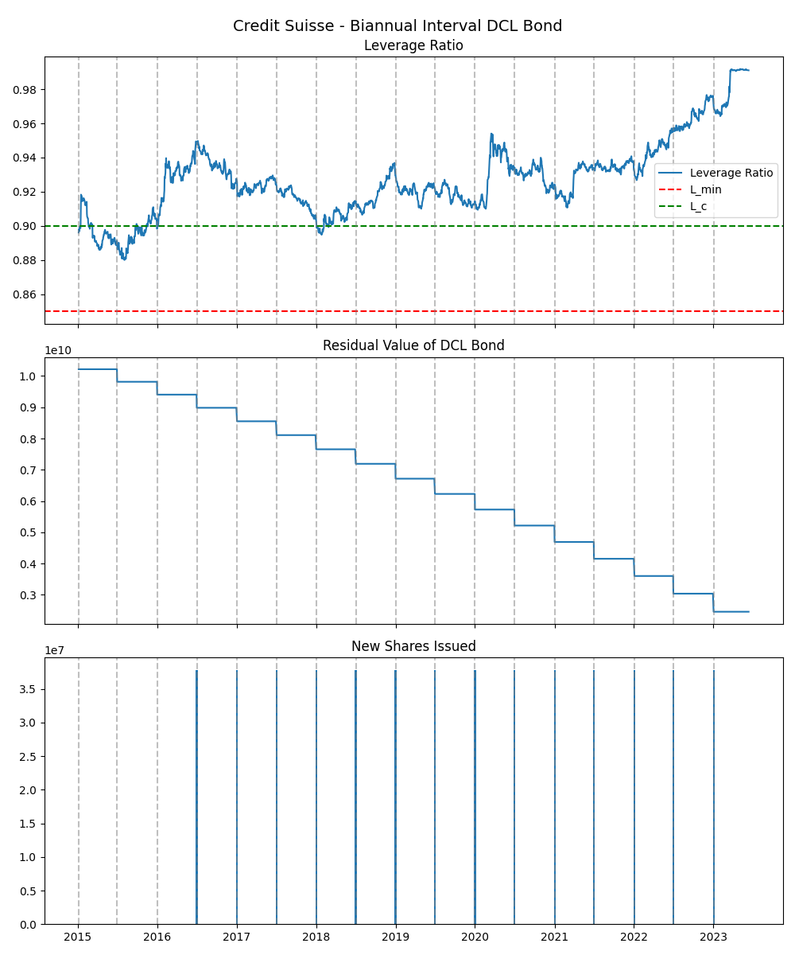


The 2023 Credit Suisse banking collapse would have been mitigated if it had applied a Dynamic Control of Leverage mechanism to its AT1 debt (Contingent Convertible bonds)
Non-Cognitive Predictors of Student Success: A Predictive Validity Comparison Between Domestic and International Students
Enhancing Bank Robustness through Dynamic Control of Leverage in Contingent Convertible Bonds: A Case Study Analysis
Input data:
PRESENTER:
Steinar Björnsson
BACKGROUND:
The 2023 collapse of Credit Suisse exposed significant weaknesses in traditional Contingent Convertible Bonds (CoCos). Traditional CoCos failed due to delayed regulatory triggers and caused sudden market instability. Dynamic Control of Leverage (DCL) CoCo Bonds propose an alternative with gradual equity conversions based on continuous leverage monitoring, enhancing bank stability and predictability.
METHODS
Collected data on equity values, debt, and Additional Tier 1 (AT1) debt for Credit Suisse via Refinitiv Eikon and quarterly company financial reports (20-F).
Simulated results of adding Dynamic Control of Leverage (DCL) dynamics to the AT1 debt.
Interpret the results (leverage adjustments, shareholder dilution, additional share issuances, etc…)
RESULTS
DCLs can significantly correct leverage given time, and they can be used effectively to preemptively stabilize financial markets.
Detailed results:
1. Get financial data from Reuters and 20-F reports
2. Set leverage thresholds and conversion parameters
3. Run DCL simulations
4. Analyze leverage and dilution outcomes
Author:
Steinar Björnsson
Supervisors:
Sverrir Ólafsson,
Maxime Segal
Take a picture to download the full paper
Notes:
Notes:
In Powerpoint, click View > Guides
Keep text within gutter guides.
Author list: Don’t split names onto two lines (e.g., “Jimmy [break] Smith”). If that happens, use a new line, unless you need the space. Bold the first names of anybody who’s presenting in person.
Intro/methods/result: Do not drop below font size 28, but if you have extra space, jack up the font size until the space is full.
Do not use color in the sidebars except in graphs/figures. It’ll pull attention from the center and slow interpretation for passersby.

